Slide 1

ARDUINO
BIOE 3090
3/10/2020

Slide 2
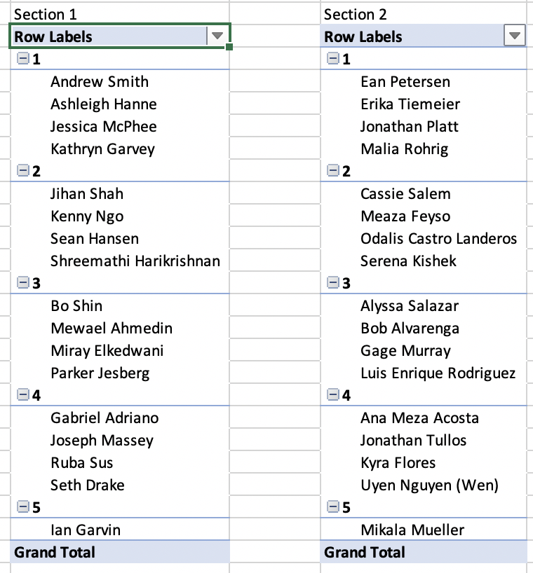
Teams

Slide 3
Zoom
Links will be on canvas
CU Anschutz ITS Zoom
https://www1.ucdenver.edu/offices/office-of-information-technology/software/how-do-i-use/zoom
https://ucdenver.zoom.us/

Slide 4
Introduce the Challenge
User Needs Worksheet
DCW – User Story to User Needs
8-min

Slide 5
User Needs
Class discussion

Slide 6
Micropump
Control?

Slide 7

ARDUINO - IDE
WHAT IS AN IDE?
WHY USE AN IDE?

Slide 8
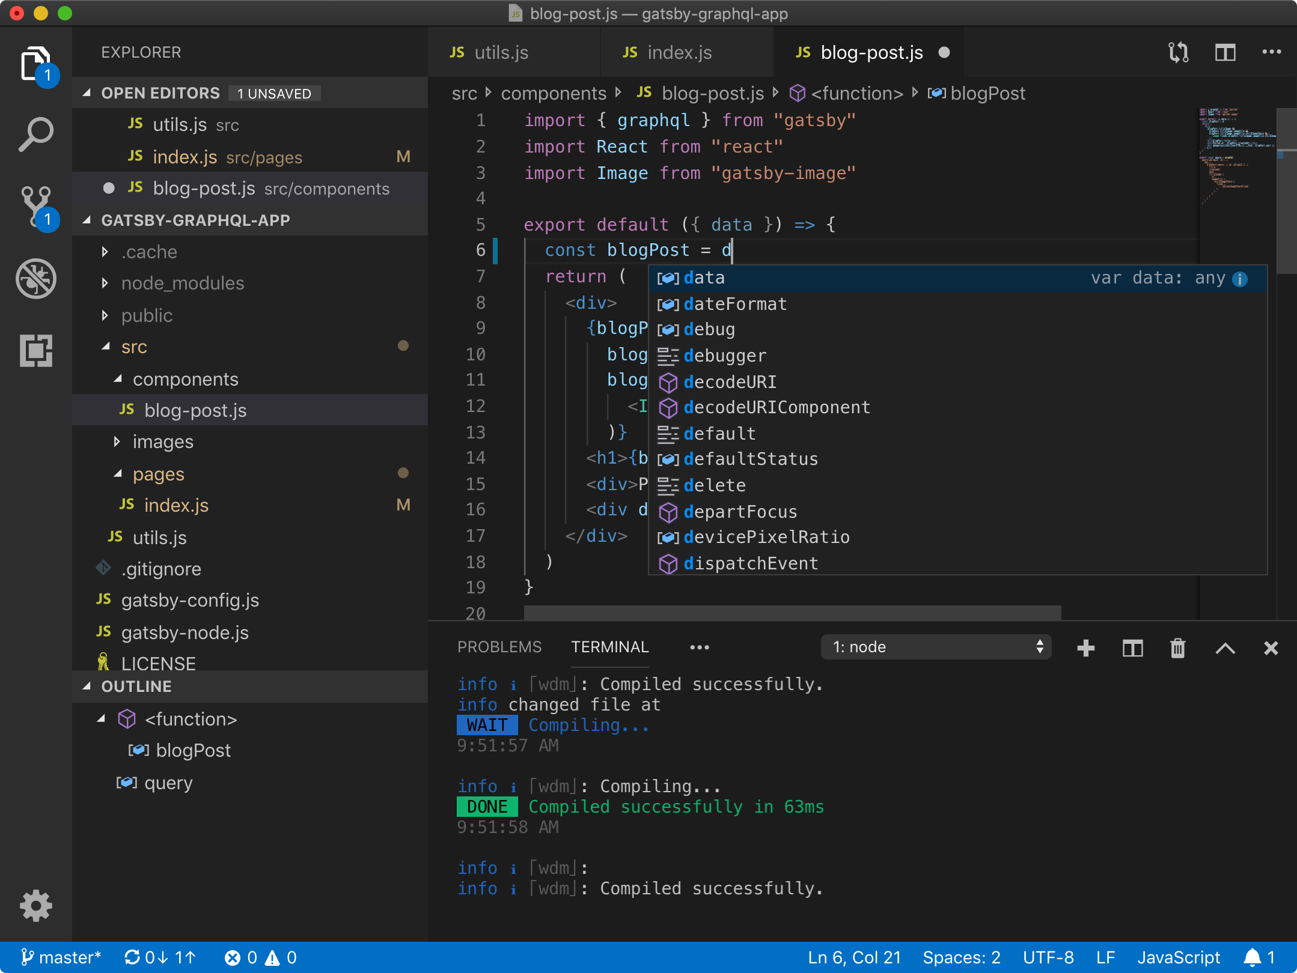
IDE ALTERNATIVES
VS-Code
Notepad ++
Emacs
Vim
Atom

Slide 9
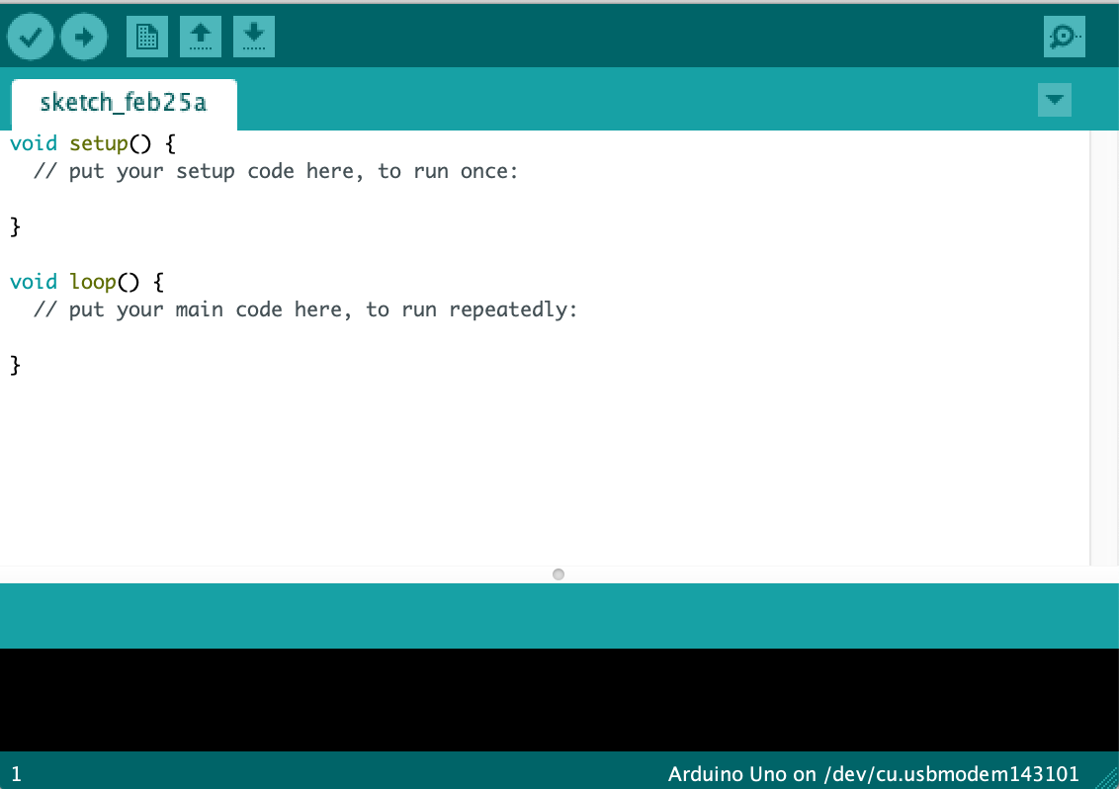
ARDUINO IDE
Integrated
Development
Environment

Slide 10
ARDUINO IDE
Setup

Slide 11
ARDUINO IDE
Main Loop

Slide 12
ARDUINO IDE
Compile and Run
Compile

Slide 13
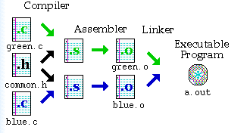
Compile?

Slide 14
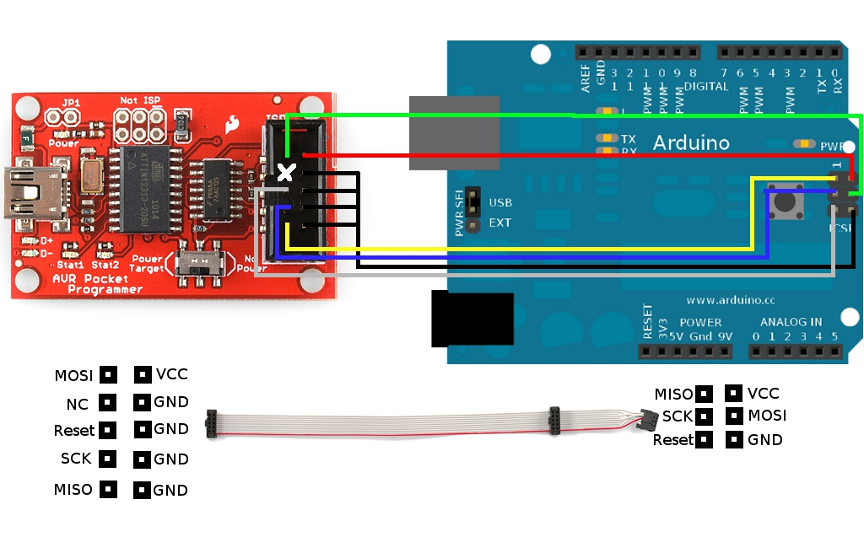
Bootloader

Slide 15
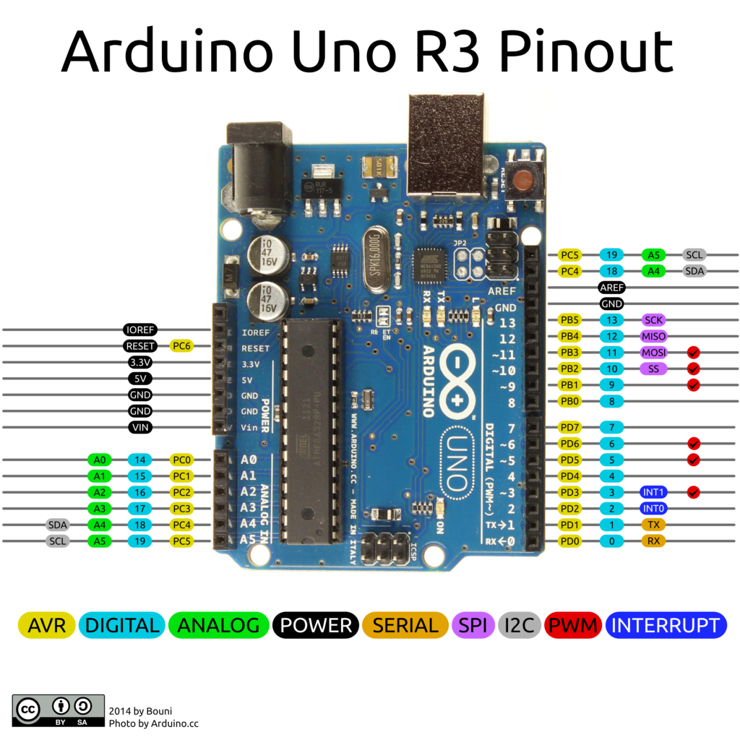
Pinout

Slide 16

Activity 1 – Anatomy of the Board

Slide 17

Arduino Programming ≠ Script Kiddie

Slide 18
Flowchart Pseudocode
Direction and order of program execution
Beginning | end
Of program
Comment statements
Point where input| output from program
Beginning of a repetition.
Assignment of value to a variable | constant. May be result of computation (Include in rect.)
Algorithm specified outside program
Point where decision is made
Combine flow lines
https://www.owlnet.rice.edu/~ceng303/manuals/fortran/FOR3_3.html

Slide 19
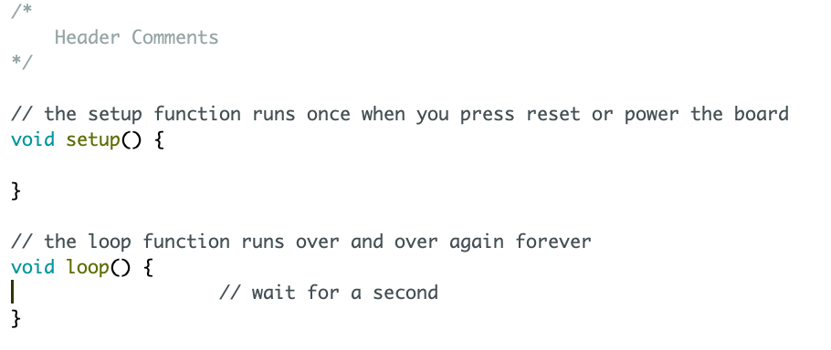
Program Flowchart
Begin
Setup
Loop

Slide 20
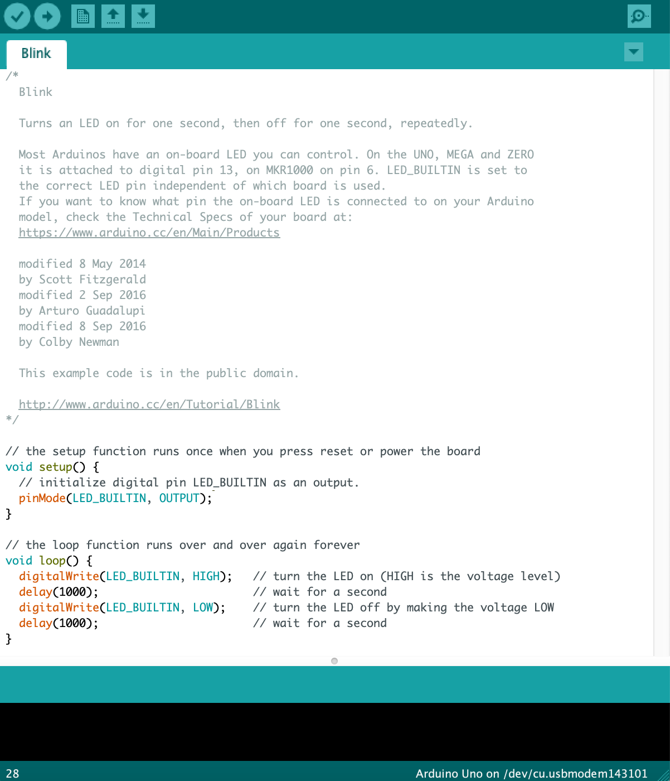
Comments
Header Comment

Slide 21
Header Comment
/*
Blink
Turns an LED on for one second, then off for one second, repeatedly.
Most Arduinos have an on-board LED you can control. On the UNO, MEGA and ZERO
it is attached to digital pin 13, on MKR1000 on pin 6. LED_BUILTIN is set to
the correct LED pin independent of which board is used.
If you want to know what pin the on-board LED is connected to on your Arduino
model, check the Technical Specs of your board at:
https://www.arduino.cc/en/Main/Products
modified 8 May 2014
by Scott Fitzgerald
modified 2 Sep 2016
by Arturo Guadalupi
modified 8 Sep 2016
by Colby Newman
This example code is in the public domain.
http://www.arduino.cc/en/Tutorial/Blink
*/
/*
Blink_3090
Turns an LED on for one second, then off for one second, repeatedly.
Pin 13 – Digital out: LED
created 25 Feburary 2020
by Steve Lammers
This example code is in the public domain.
Source code adapted from - http://www.arduino.cc/en/Tutorial/Blink
*/

Slide 22
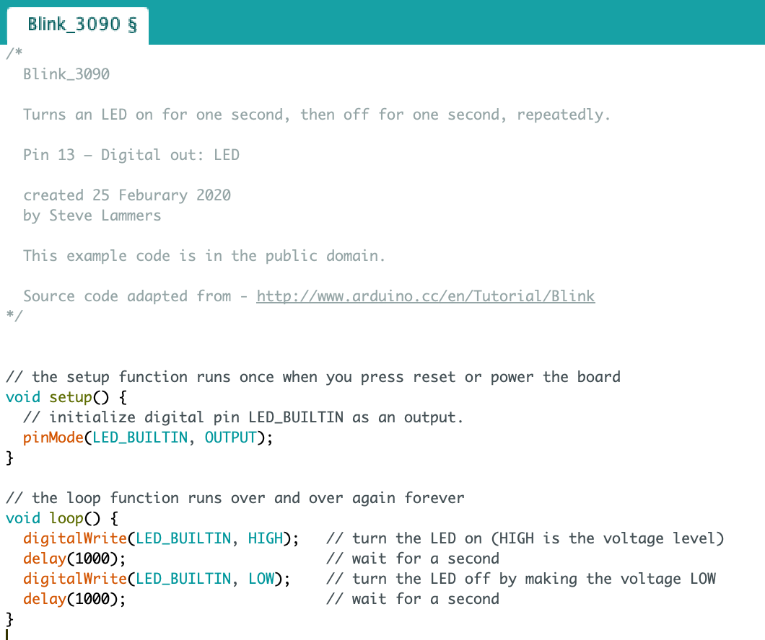
Comments
Function Comment

Slide 23
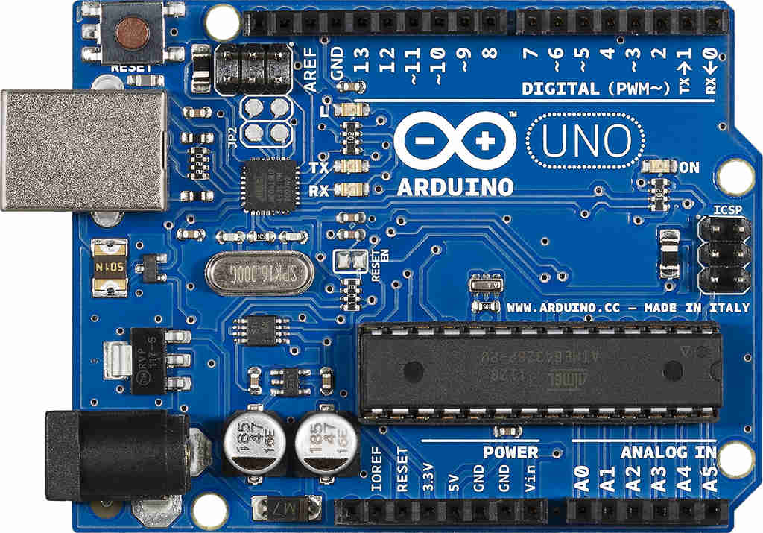
pinMode
pinMode(LED_BUILTIN, OUTPUT);

Slide 24
Activity 2 – Blink

Slide 25
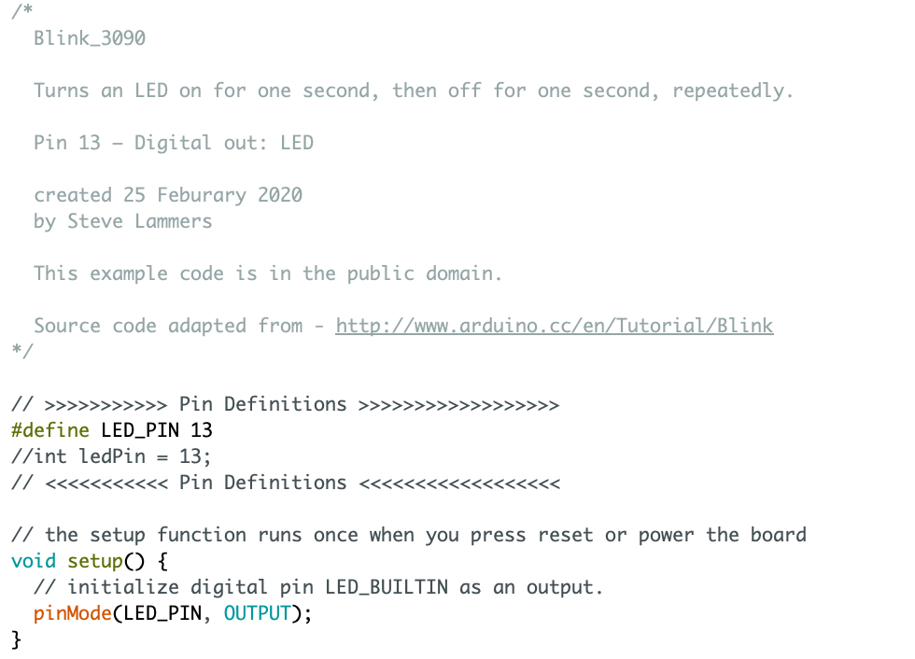
Pin Definitions
#define identifier token-string
OR
int ledPin = 13;
Section Comment

Slide 26


Debugging

Slide 27
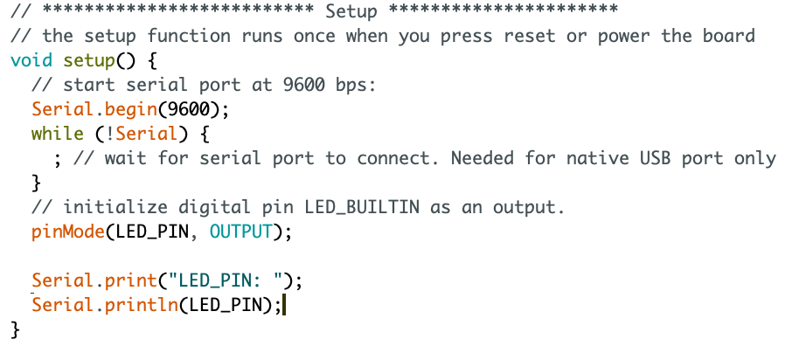
Print Statements

Slide 28
Testing
Unit Testing
Ad-hoc Testing

Slide 29
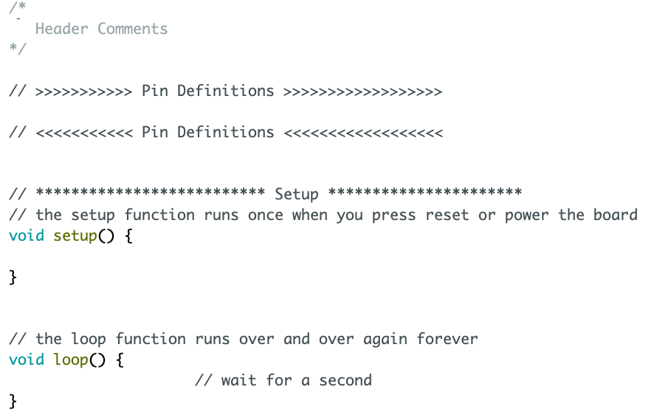
Current Program Flowchart
Begin
Pin Definitions
Setup
Loop

Slide 30
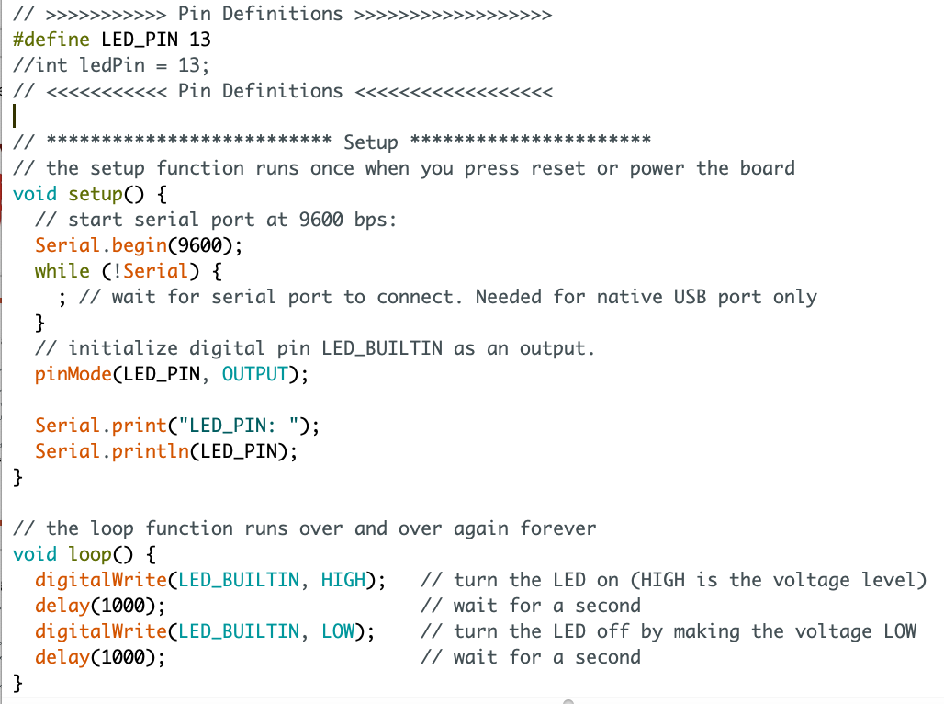
Main Loop – Functional Programming
Add This
Change This
Functionalize This

Slide 31
Activity 3 – Simplify the Main Loop

